Slide 1




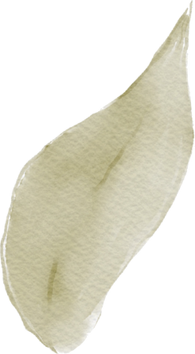






SPAM CLASSIFICATION
Research paper by Argha Ghosh and A. Senthilrajan
Fatimah Aldukhi 221434337
Shahad Bu saqer 221431019
Fatimah Alyousef 221433107

Slide 2
List of Contents
1
5
Introduction
Strengths of the Research
2
6
Weaknesses of the Research
Methodology Overview
3
7
Conclusion
Results
4
8
References
Analysis of Results

Slide 3





Introduction
In the digital age, the proliferation of spam emails poses a significant threat to user security and privacy. To combat this issue, this study explores the application of various machine learning techniques to accurately classify emails as spam or legitimate. By implementing and evaluating these classifiers, the authors aim to contribute to the development of more effective spam detection mechanisms and enhance email security.

Slide 4
Methodology Overview
• Data Collection: Two datasets (Spam Corpus and Spambase).
• Data Preprocessing: Analyzing and extracting important features from emails.
• Algorithm Implementation: 13 machine learning algorithms, including logistic regression, SVM, and neural networks.
• Performance Evaluation: Metrics used (accuracy, recall, error rate).

Slide 5
Results and Analysis
• The Random Forest classifier was the most effective, achieving accuracy rates of 99.91% and 99.93% on the Spam Corpus and Spambase datasets, respectively.
• The Naïve Bayes classifier performed poorly, with accuracy rates of 87.63% and 79.53%, primarily due to its assumption of feature independence.
• The analysis also revealed that while Random Forest excelled, classifiers like J48 and Bootstrap Aggregating performed moderately well.

Slide 6
Strengths of the Research
• Types of algorithms applied: The paper compared 13 different algorithms.
• Performance Analysis: Thorough evaluation using clear metrics.
• Reliable results: Random Forest proved to be the most efficient algorithm.

Slide 7
Weaknesses of the Research
• Limited Datasets: May not represent all types of spam.
• Performance of Naïve Bayes: turned in weak performance compared to other algorithms
• Limited Recommendations: While valuable results were presented, the study may lack clear recommendations.

Slide 8
Conclusion
• Summary of the findings.
• Random Forest achieved the highest accuracy (99.91% on Spam Corpus and 99.93% on Spambase).
• Naïve Bayes had relatively lower accuracy.
• Insights for improving spam filtering systems.

Slide 9
References
Ghosh, A., & Senthilrajan, A. (2023). Comparison of machine learning techniques for spam detection. Multimedia Tools and Applications, 82(19), 29227-29254.‏

